Slide 1
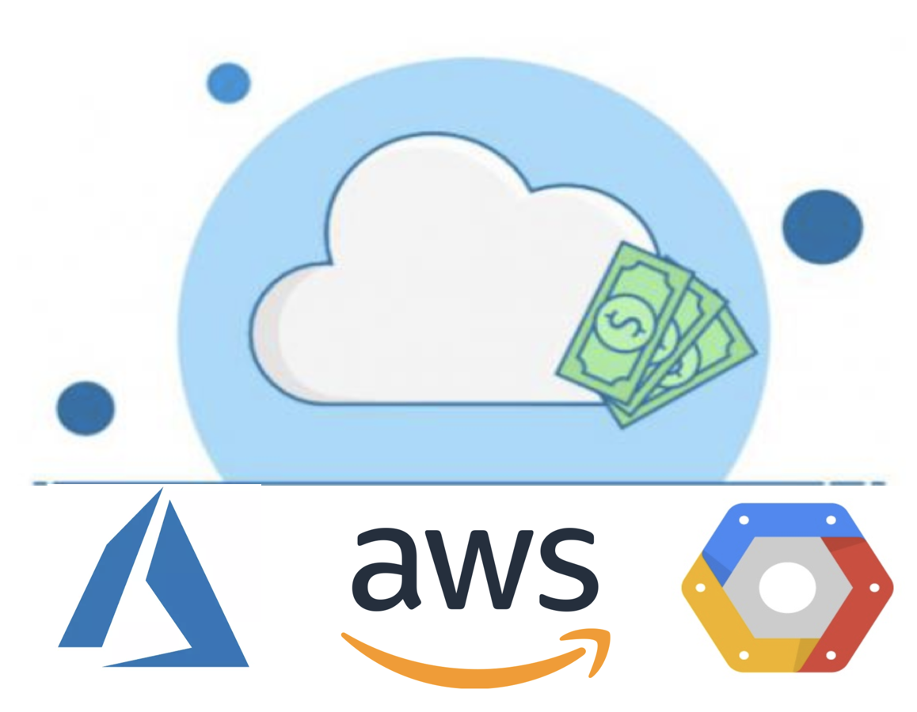


Cloud Financials
Starbucks Technology

Slide 2
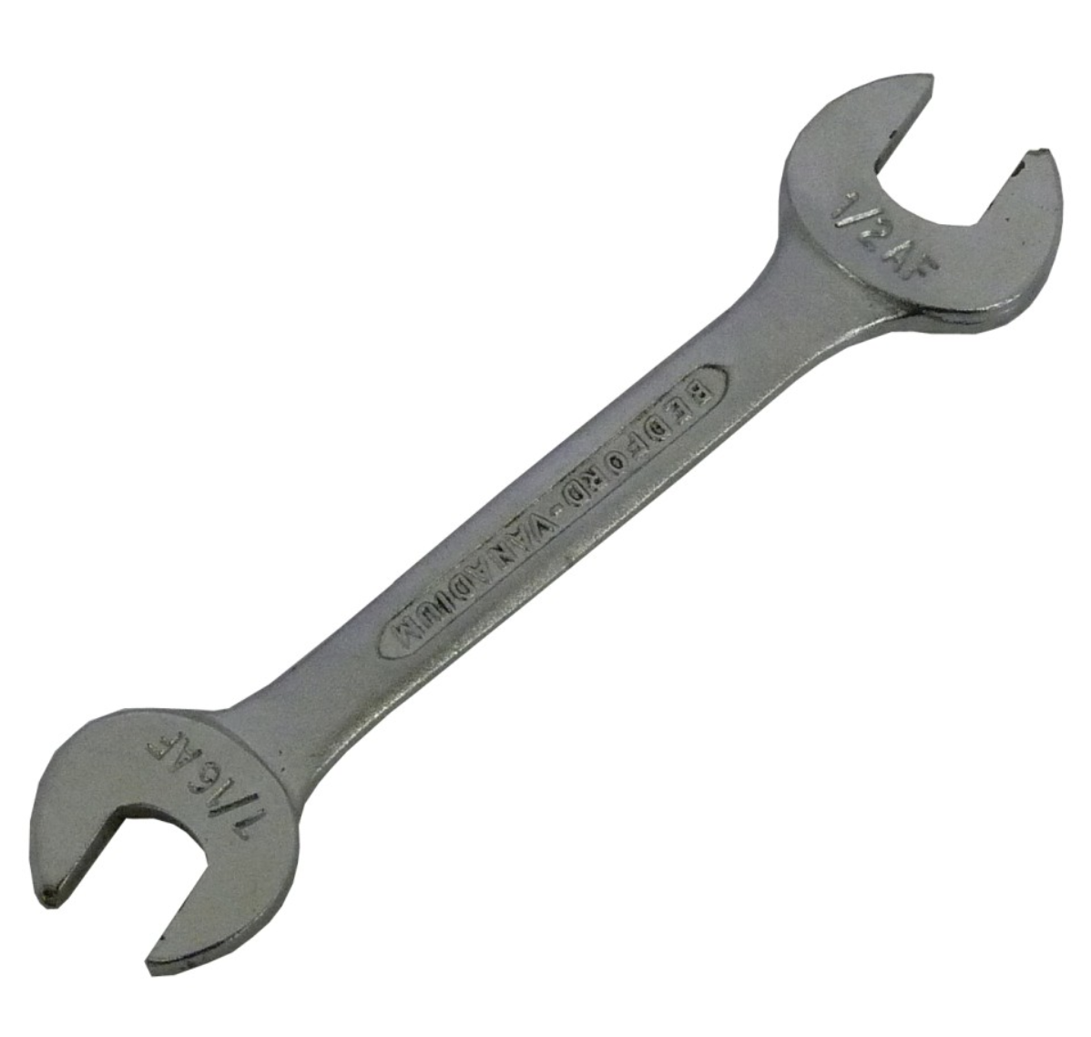

Why should I know about cost?

Slide 3




Why Cloud ?

Slide 4
Why Cloud?
Business Agility
Financial Agility

Slide 5
How can you achieve?
Micro-services
Automation
Take advantage of the Cloud Features

Slide 6

Monolith→ Micro-services

Slide 7
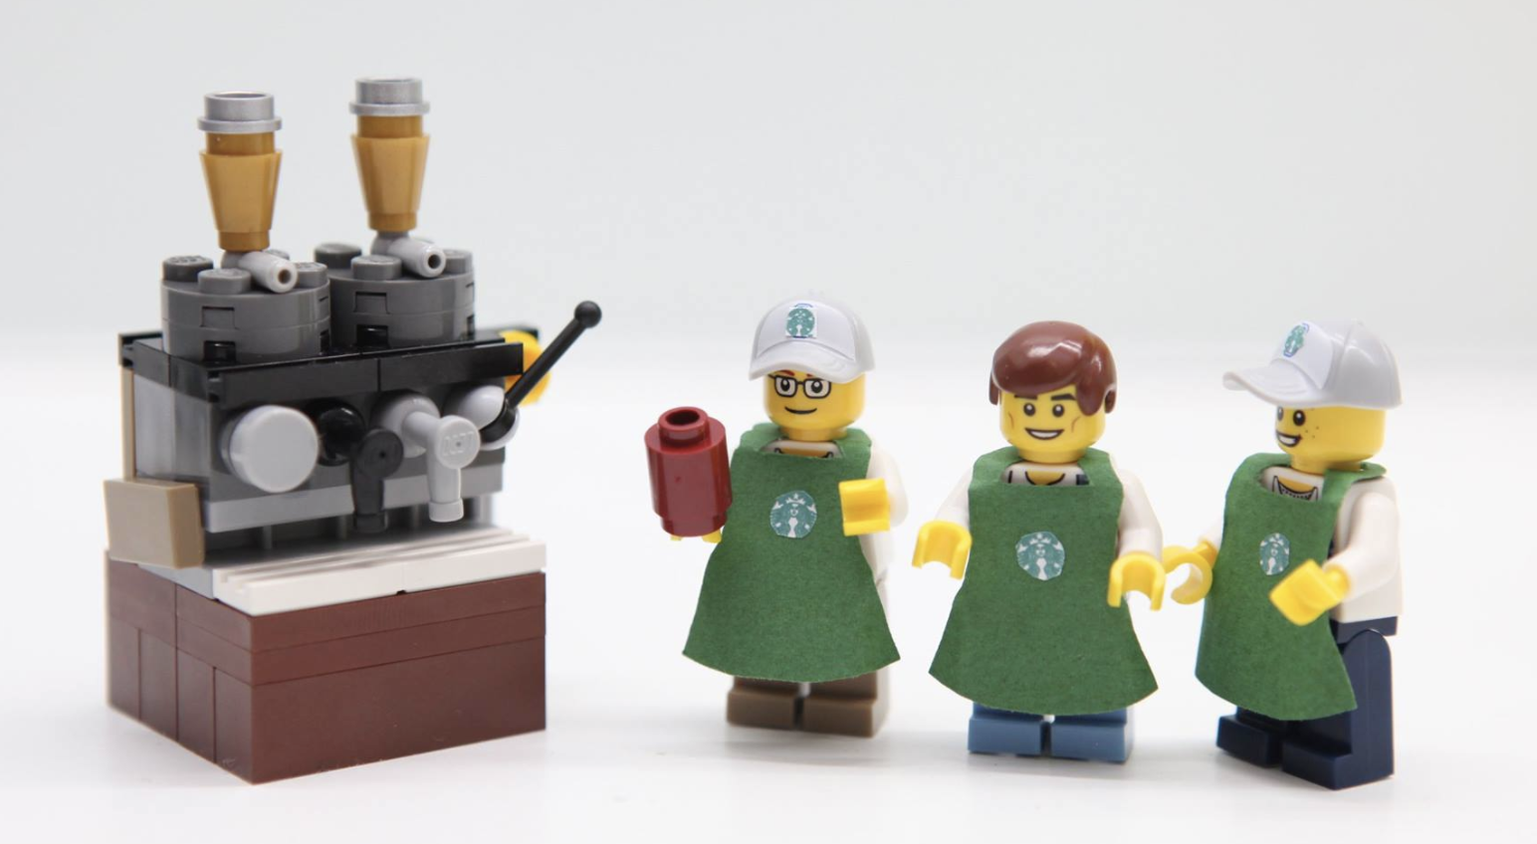
Micro-services

Slide 8

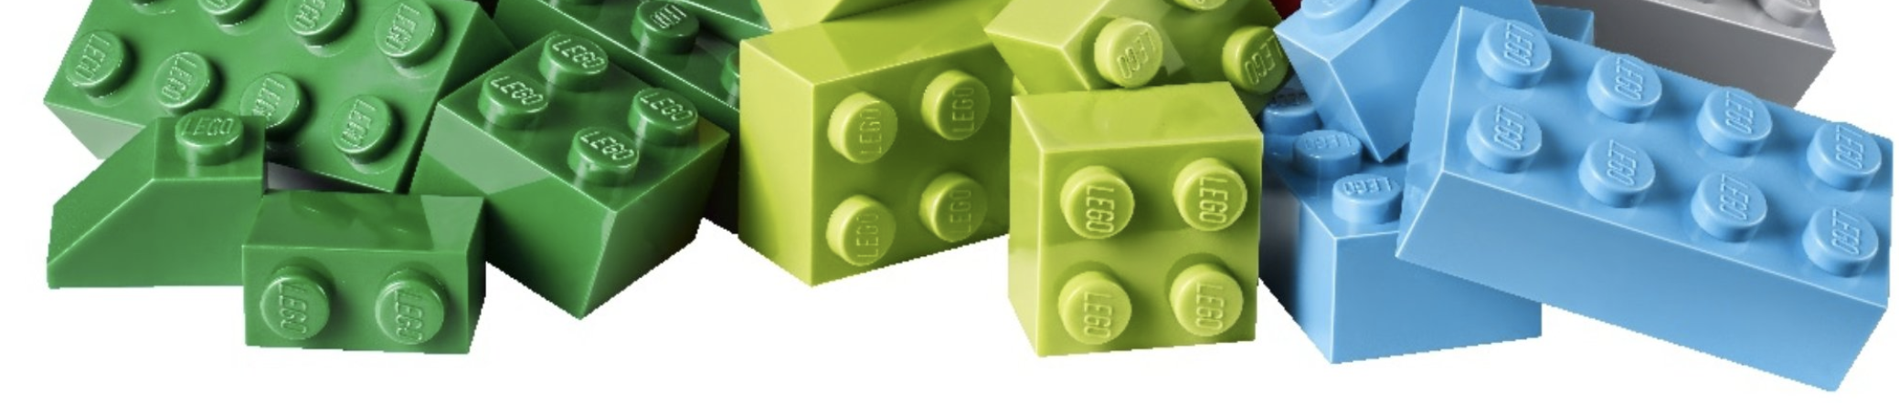
Micro-services
Small; Independent; Isolated; Decoupled.
Enables Continuous Delivery.
Design for failure.

Slide 9

Automate Everything!

Slide 10

Automate Everything!
Infrastructure as Code.
Use API’s to automate.

Slide 11

Infrastructure as Code * Flexible to use the same template across cloud tenants. * Easier to manage. * Cloud agnostic tools.

Slide 12
API’s: * Auto Shutdown – minimize unused resources * Auto scale-up/ down * Resize VM – consider VM SKU & region

Slide 13
Take Advantage!

Slide 14

Take Advantage!
Elasticity
High Availability
Pay as you go
Empowerment

Slide 15
Tools - Azure

Slide 16
Tools - Azure
Azure Pricing
Azure Pricing Calculator
Azure Advisor
Azure - Cost Analysis

Slide 17
Azure Pricing

Slide 18
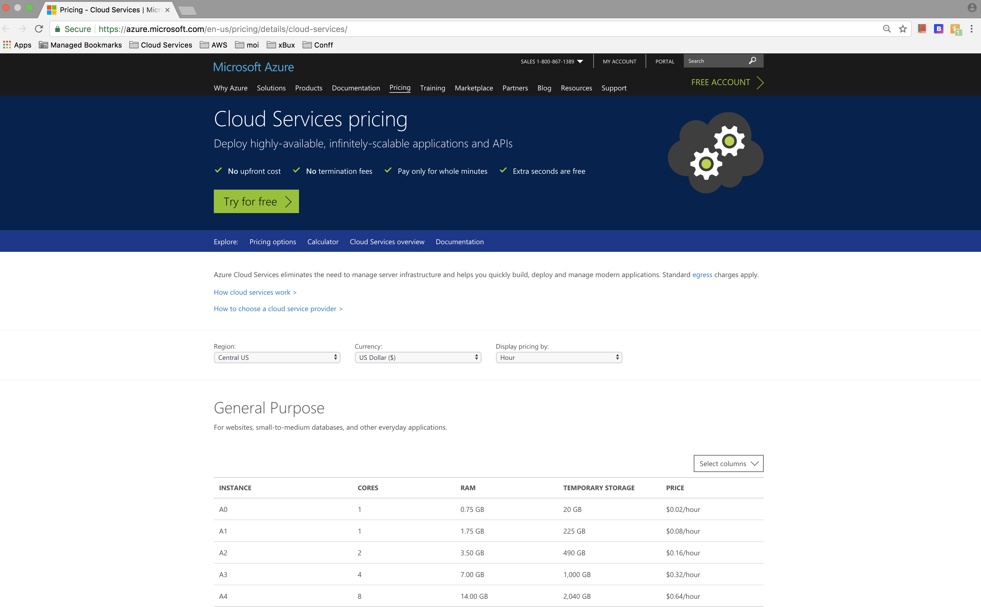
Azure – Pricing
https://azure.microsoft.com/en-us/pricing/details/cloud-services/

Slide 19
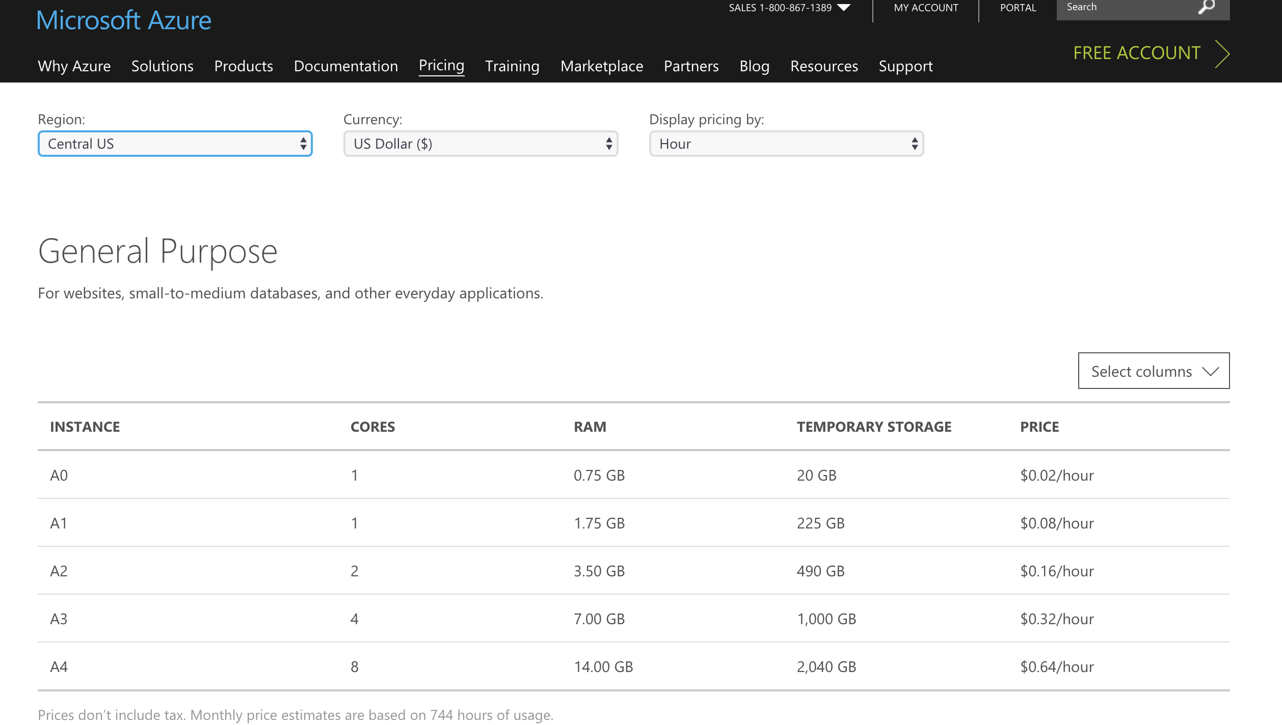
Azure – Pricing

Slide 20
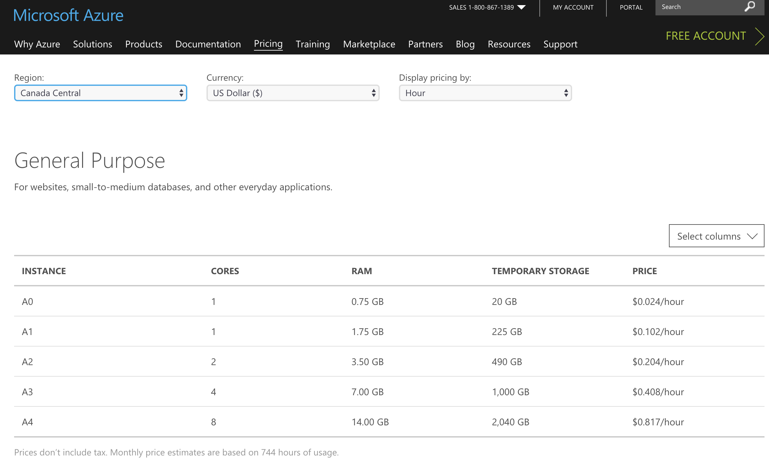
Azure – Pricing

Slide 21
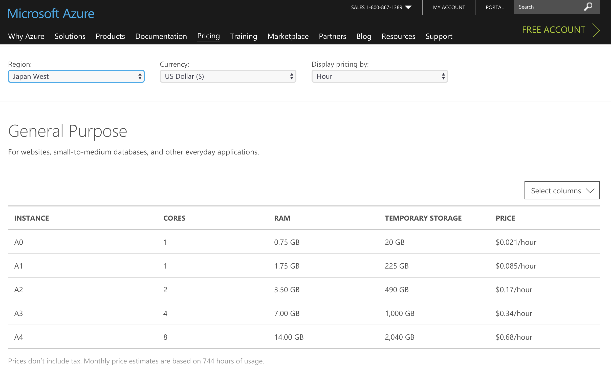
Azure – Pricing

Slide 22
Azure Pricing Calculator

Slide 23
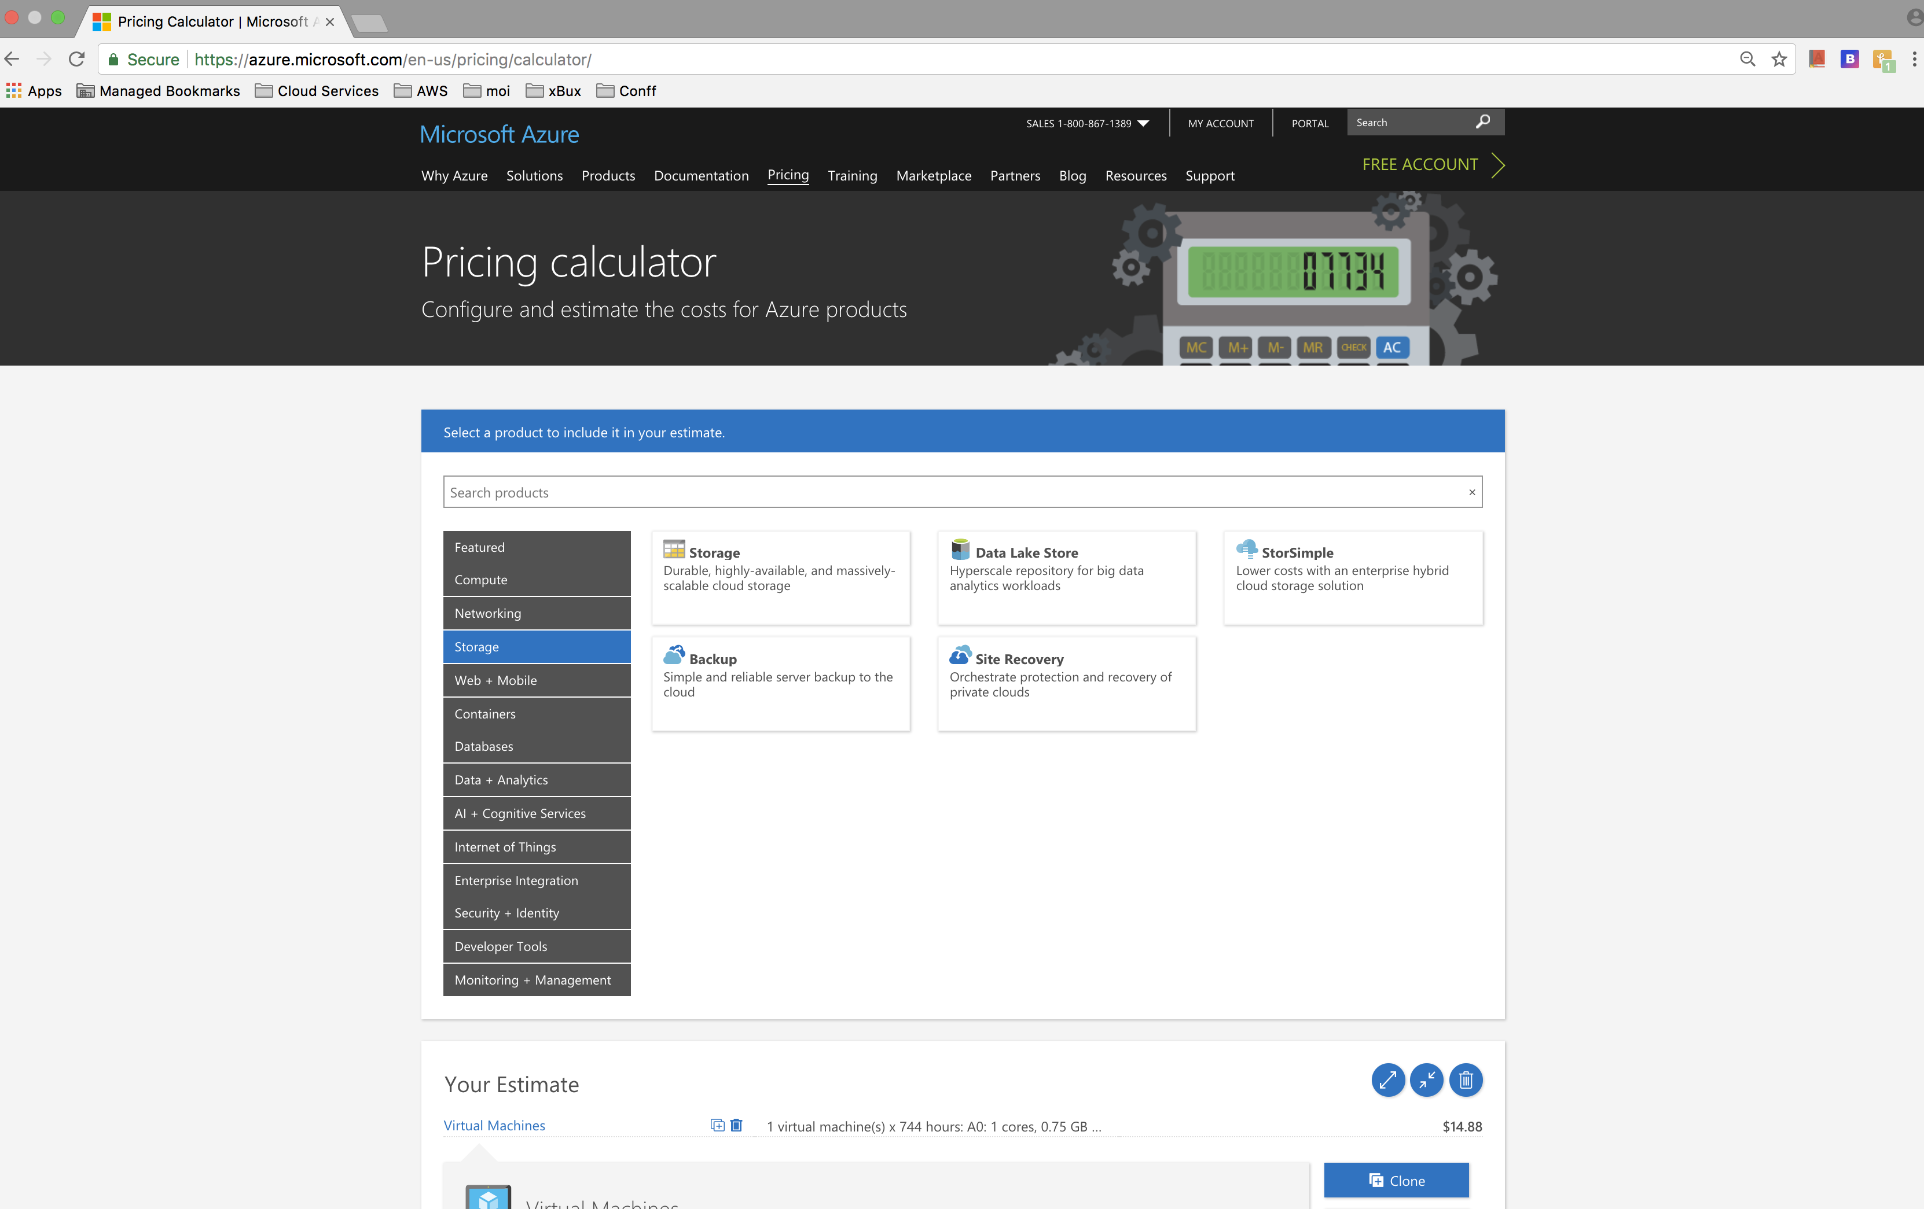
Azure – Pricing Calculator
https://azure.microsoft.com/en-us/pricing/calculator/

Slide 24
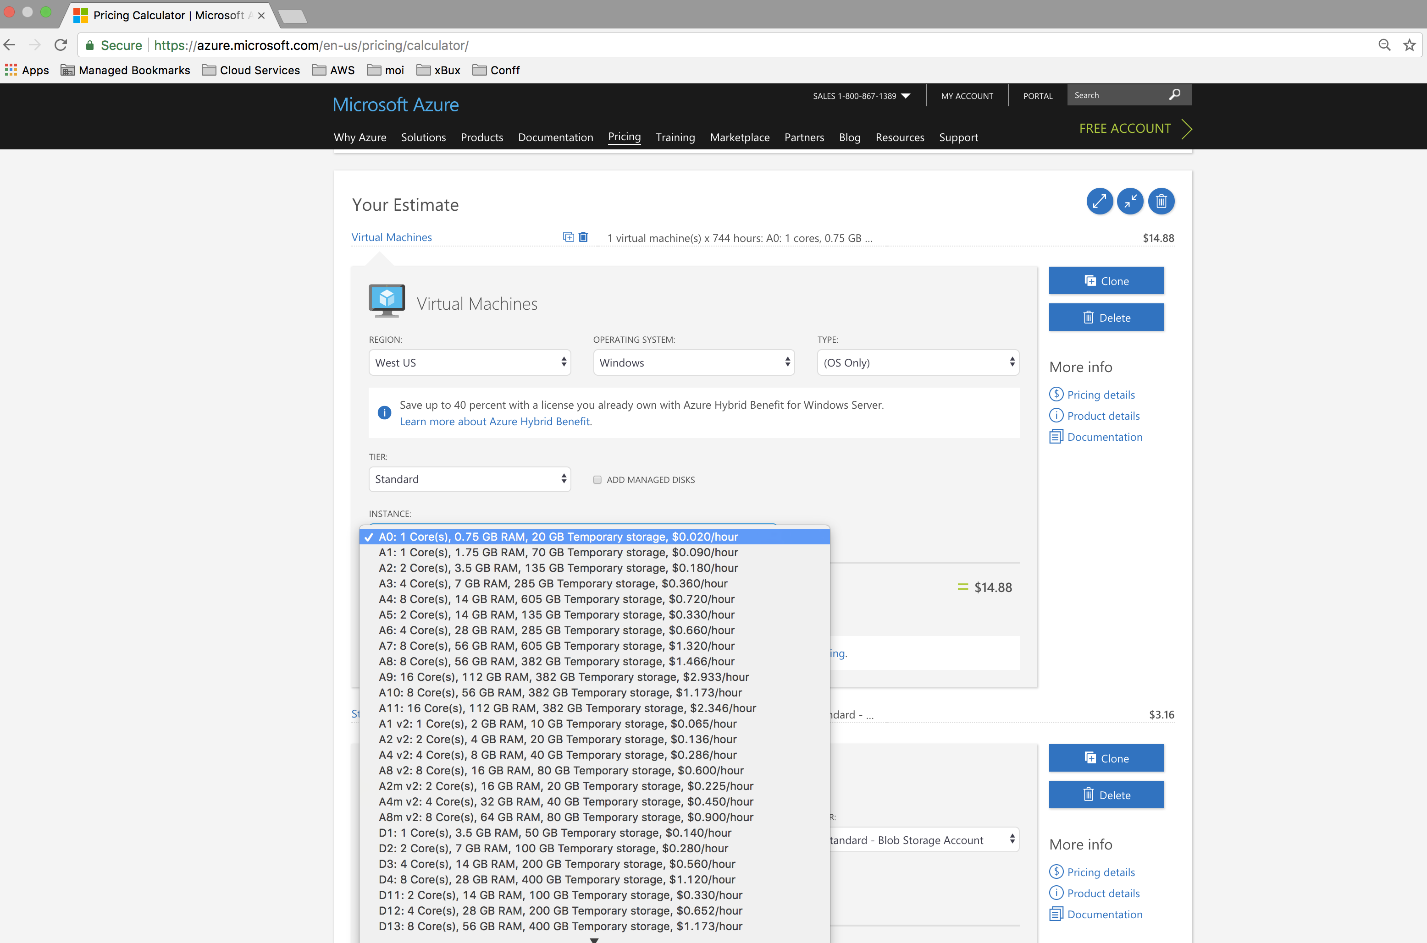
Azure –Pricing Calculator
https://azure.microsoft.com/en-us/pricing/calculator/

Slide 25
Azure Advisor

Slide 26
Azure Advisor
Helps you follow best practices.
Optimize your Azure deployments.
How?
Resource Configuration
Usage Telemetry

Slide 27
Azure Advisor - recommends on:
Cost Effectiveness
Performance
High availability
Security

Slide 28
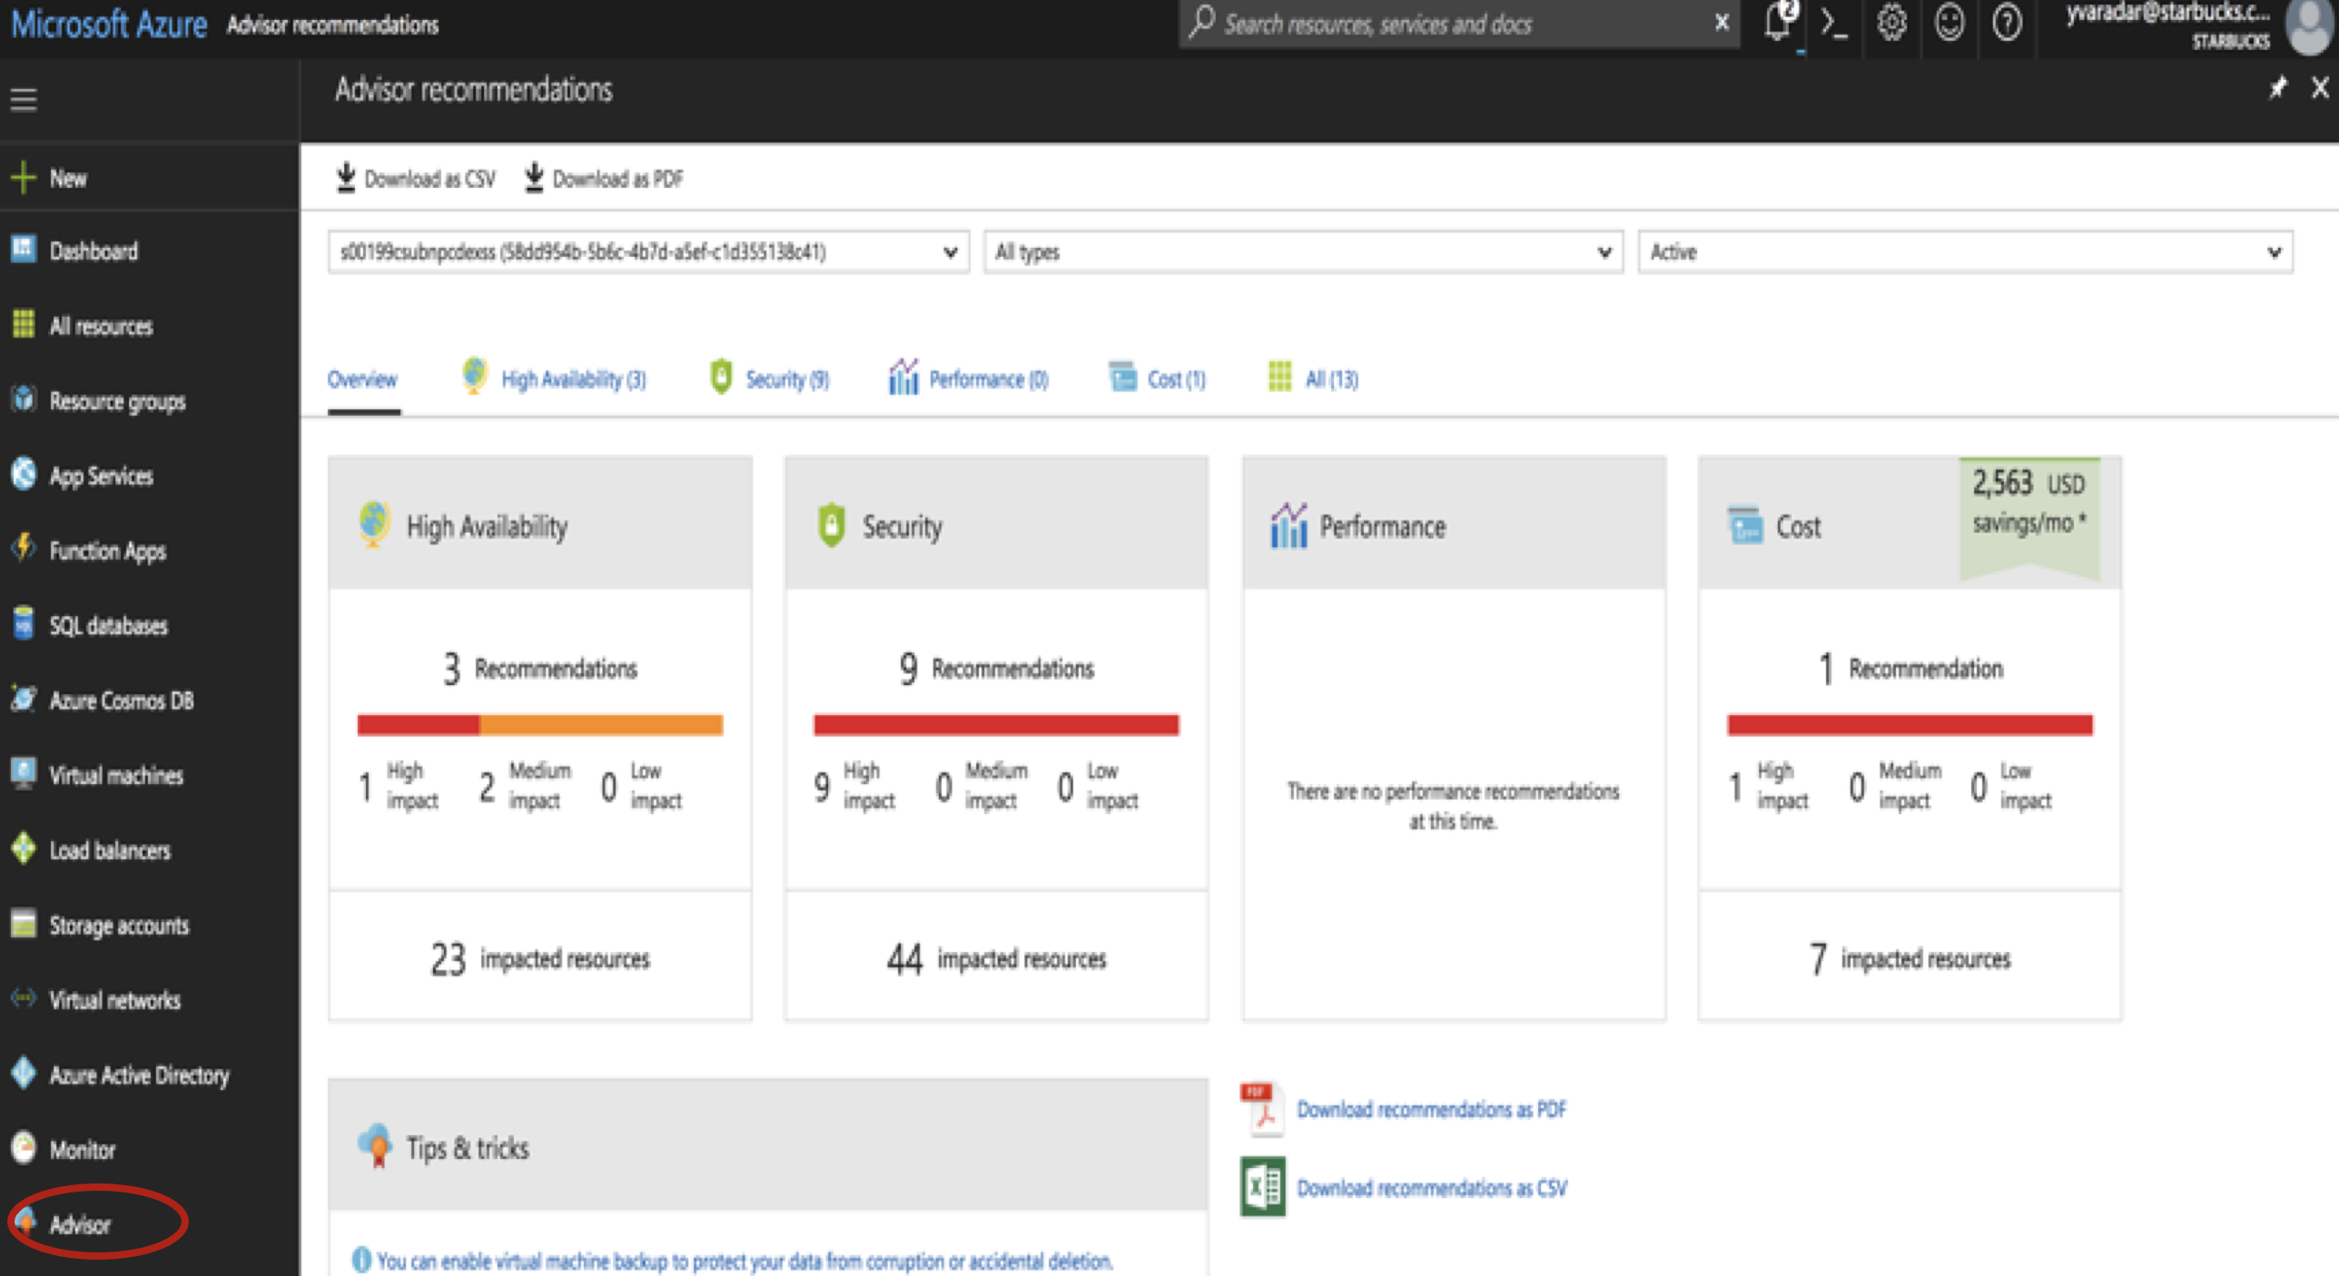
Azure Advisor

Slide 29
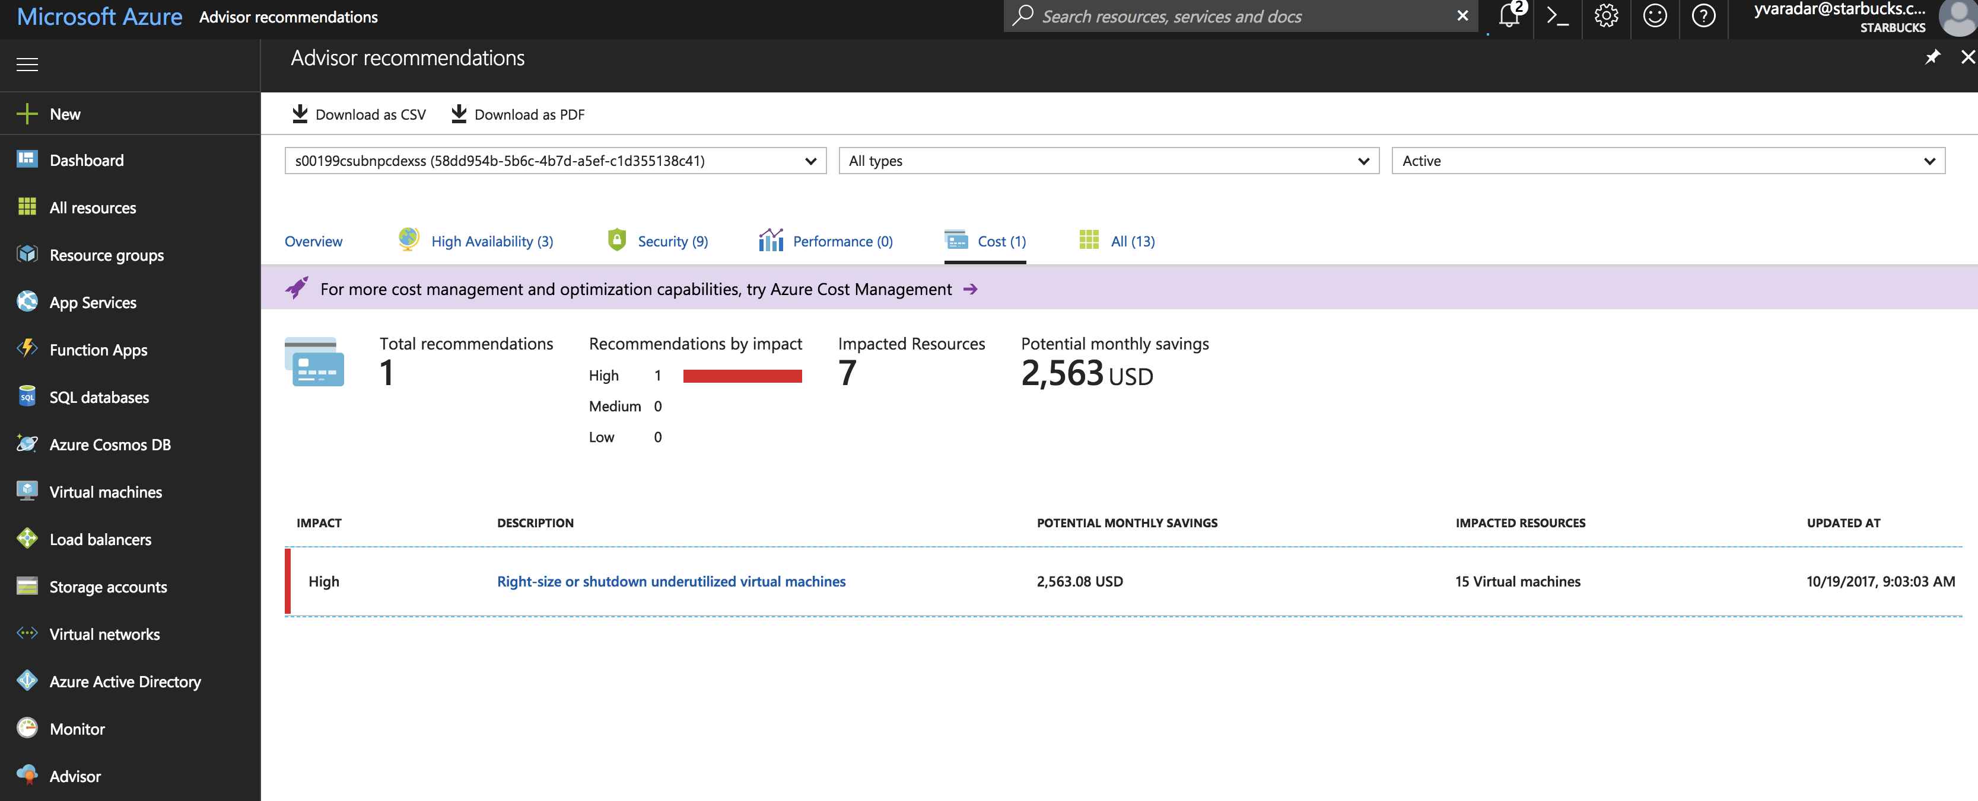
Azure Advisor

Slide 30
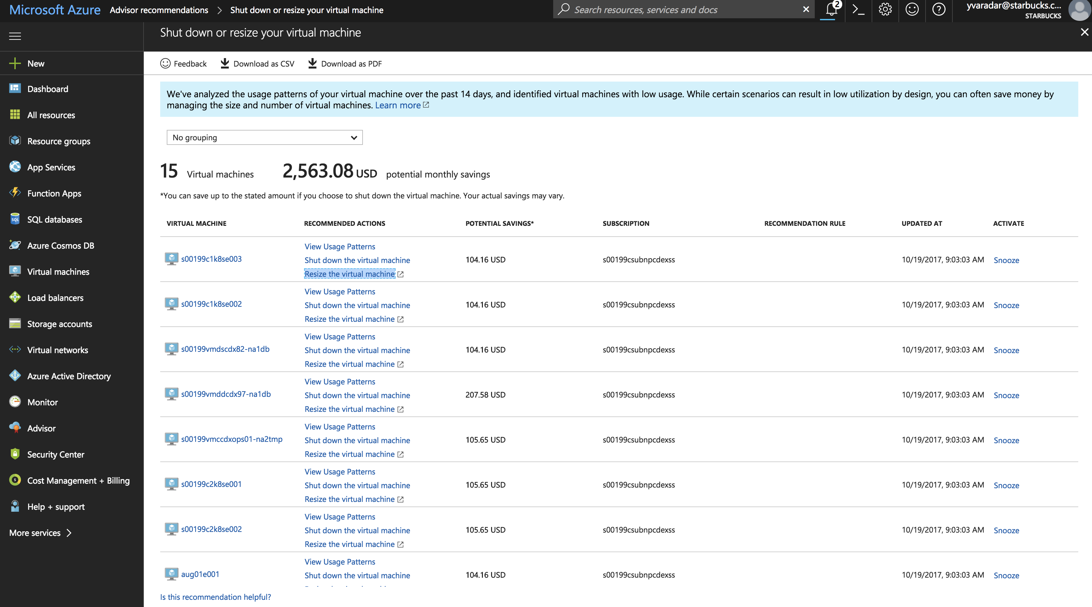
Azure Advisor

Slide 31
Cost Analysis on Azure Portal

Slide 32
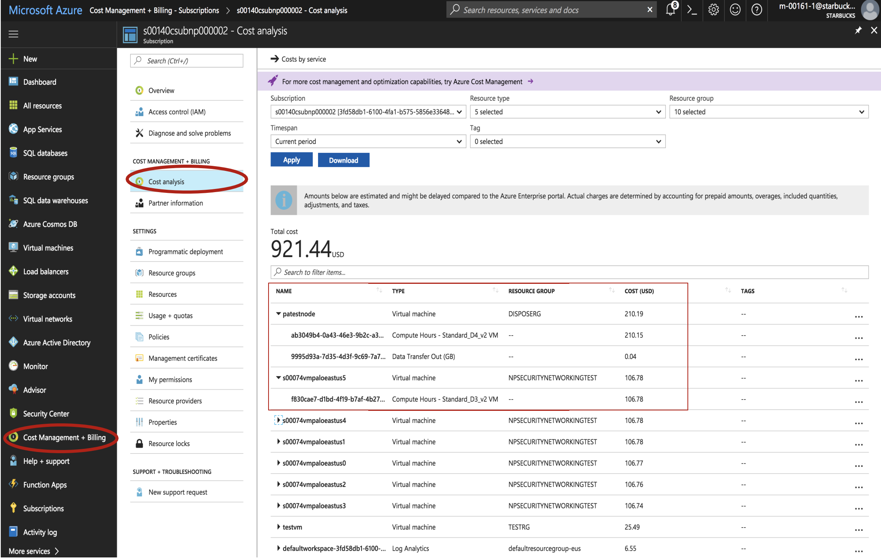
Cost Analysis on Azure Portal

Slide 33
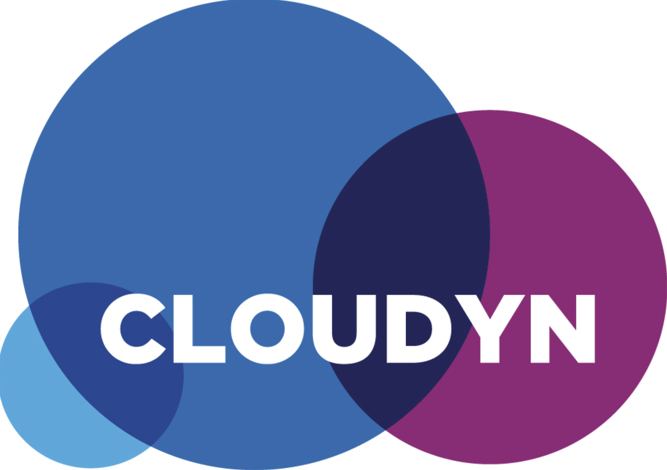
New Cost Management Tool

Slide 34

Compute
Resource Type or SKU / Region
Data Transfer
IP
OS + Data

Slide 35
For example, Data Transfer:
Be aware!
Inbound is Free!
Outbound is free within a Region!
Compute
Data
within a Region
Wise Choice ?!

Slide 36

Why not PaaS ?

Slide 37
Have you considered Serverless?
Azure Functions:
No VM maintenance like security updates etc.
You only pay for the CPU cycles you use.

Slide 38

Questions?

Slide 39

Cloud Services
Follow Cloud Services Blog: https://docs.starbucks.net/display/CS/Cloud+Services
Email: DL-CloudServicesTeam@starbucks.com

